Slide 1
eVIP basic network
Jinqing Yan

Slide 2
Agenda
eVIP Basic
Network Technology used in eVIP
Firewall in SBG Load Balance

Slide 3
What is eVIP
eVIP (envolved VIP) is a Component Based Architecture (CBA) software-based system.
Applications in one cluster can share one external IP address, VIP addresses.
SBG Load Balance is implemented with eVIP.

Slide 4

PCSCF Load Balancing
Load
Balancer
SGC blade pair
#1
Network 1
Using VIP 1
SGC blade pair
…
IS Site
SGC blade pair
#15
The VIP Load Balancing in the SBG allows the users on an access network to use one single IP address to access a set of SBG server blades that is configured in 1+1 redundancy pair.
The Load Balancer can serve 1 -15 Blade Pairs
The SBG Load Balancer is a Stateful L3 load balancer the distribution of traffic is based on the IP address of the UE.
Selection of SGC blade pair is performed when the first REGISTER message is received.

Slide 5
Basic
external
ISER/CMX
Load
Balancer
SGC/PL
SGC/PL
ISER/CMX
SGC/PL
SGC/PL
1+1 redundancy
1+1 redundancy
Default Protocol:
ospfv2v3 for IS; static route on vSBG
ECMP used;
BFD used;

Slide 6
Basic – Load Balancer
Active
FEE
SE
LBE
SGC
/PL
Standby
FEE
SE
LBE
SGC
/PL
ISER
/
CMX
FEE
SE
LBE
Active
SGC
/PL
FEE
SE
LBE
SGC
/PL
Standby
Signaling VLAN
I
v6 tunnels on internal VLAN in IS or eth3 on vSBG.
P

Slide 7
Basic – Load Balancer
Front End Element (FEE): To attract traffic destined to the VIP address and forwards the traffic to a selected SE.
Security Element (SE): The SE element and IPsec function is optional in Load Balancer. In the SBG, the SE is configured not to be used. This still means that all packets, including ESP, are passing the SE element but not encrypted/decrypted
Load Balancer Element (LBE): Performs the load balancing based and forwards the traffic to the correct SGC in the correct blade pair.
Max number of LLB: 8
Max VIPs per LLB: 10
blade_0_15:~$ lxc-ls
llb1fee_0_15 llb1lbe_0_15 llb1se_0_15 llb2fee_0_15 llb2lbe_0_15 llb2se_0_15

Slide 8
Basic – Element Selection
weighted round-robin
2 tuple hash {src ip , dst ip}
Active
FEE
SE
LBE
SGC
/PL
ECMP
round-robin
Standby
FEE
SE
LBE
SGC
/PL
ISER
/
CMX
Active
FEE
SE
LBE
SGC
/PL
FEE
SE
LBE
SGC
/PL
Standby
2 tuple hash

Slide 9
Basic - Multiple VIPs in one LLB
SGC 1
SIP Netw. Conn. v4 (VIP1-IPv4)
VIP1-IPv4
Sign. Netw. Conn. IPv4
VIP2-IPv4
Sign. Netw. Conn. IPv6
SIP Netw. Conn. v6 (VIP4-IPv6)
LLB
VIP3-IPv4
VIP4-IPv6
Sign. Netw. Conn. IPv4
SIP Netw. Conn. v4 (VIP2-IPv4)
VIP5-IPv6
Sign. Netw. Conn. IPv4
SIP Netw. Conn. v4 (VIP3-IPv4)
Sign. Netw. Conn. IPv6
SIP Netw. Conn. v6 (VIP5-IPv6)
Access Network 1
SGC 2
SIP Netw. Conn. v4 (VIP1-IPv4)
Access Network 2
Sign. Netw. Conn. IPv4
Sign. Netw. Conn. IPv6
SIP Netw. Conn. v6 (VIP4-IPv6)
Access Network 3
Sign. Netw. Conn. IPv4
SIP Netw. Conn. v4 (VIP2-IPv4)
one LLB only
has one VR
Sign. Netw. Conn. IPv4
SIP Netw. Conn. v4 (VIP3-IPv4)
Sign. Netw. Conn. IPv6
SIP Netw. Conn. v6 (VIP5-IPv6)

Slide 10
Basic - Configuration
IS MO
vSBG MO
IS GUI

Slide 11
Is SBG MO view
Parent child
If you want two SIP Networks to use the same Load Balancer:
Create two AccessNetPcscf/SipPa and let them use two different VIP addresses on the same LLB
If you want two Blade Pairs to handle traffic from one SIP network. :
Create two AccessNetPcscf/SipP on the two Blade systems and and let them use the same VIP address
IntegratedSIte
Reference
1
Global MOC
Blade Systems
[0..N]
Blade System
1
SGC
PCSCF
…
Interfaces
…
[0..998]
LoadBalancer
AccessNetPcscf
networkId
networkName
vlanId
NextHopAddress
[0..8]
LLB
0..1
SipPa
vipAddressName
moRef: vipaddressRef?
ipAddress
tcpPort/udpPort
[0..10]
VIPAddress
ipAddress
Tcp/udpPort
sourceAddressStickiness
A vlan named “lb_internal_vlan” must be created firstly and reboot SGC to enable eVIP component.

Slide 12
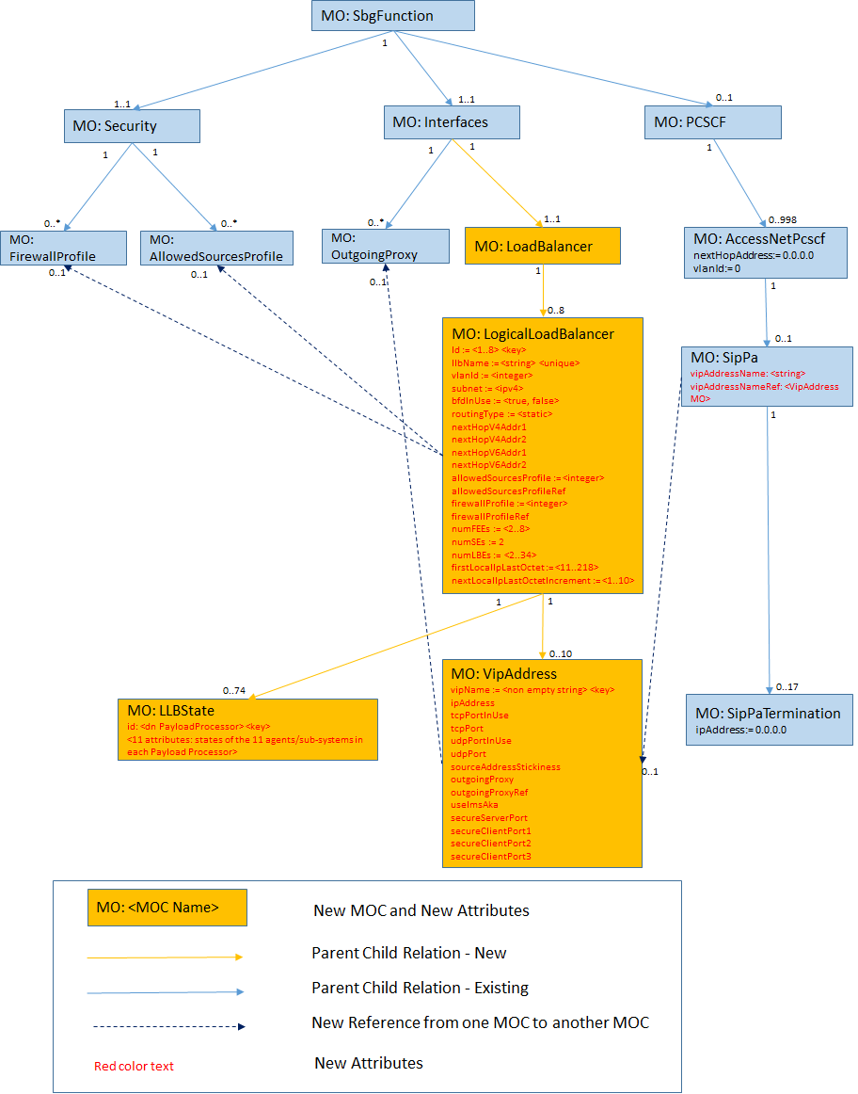
vSBG MO View
> eVIP component is always enabled in vSBG.

Slide 13
GUI

Slide 14
Basic – evipc CLI
Using “telenet fe80::1234%evip_macvlan0 25190” to login to eVIPc CLI.

Slide 15
Basic – Code Modules
evip.xml
evipI.erl evipLoad.erl evipLib.erl evip.erl evipDtm.erl | evip_start.sh evip_startup_cmds.sh evip_get_vlan.sh evip_asilog.sh | evip_ch.upgSrc evip_gen.upgSrc evip_ch.appSrc evip_gen.appSrc
telnet CLI
evip_dtm.c
evip component

Slide 16
Basic Technology in eVIP
Basic (vlan, route…)
VR (Linux namespace)
Veth/Bridge
Macvlan
IP6 Tunnel
Linux Virtual Server

Slide 17
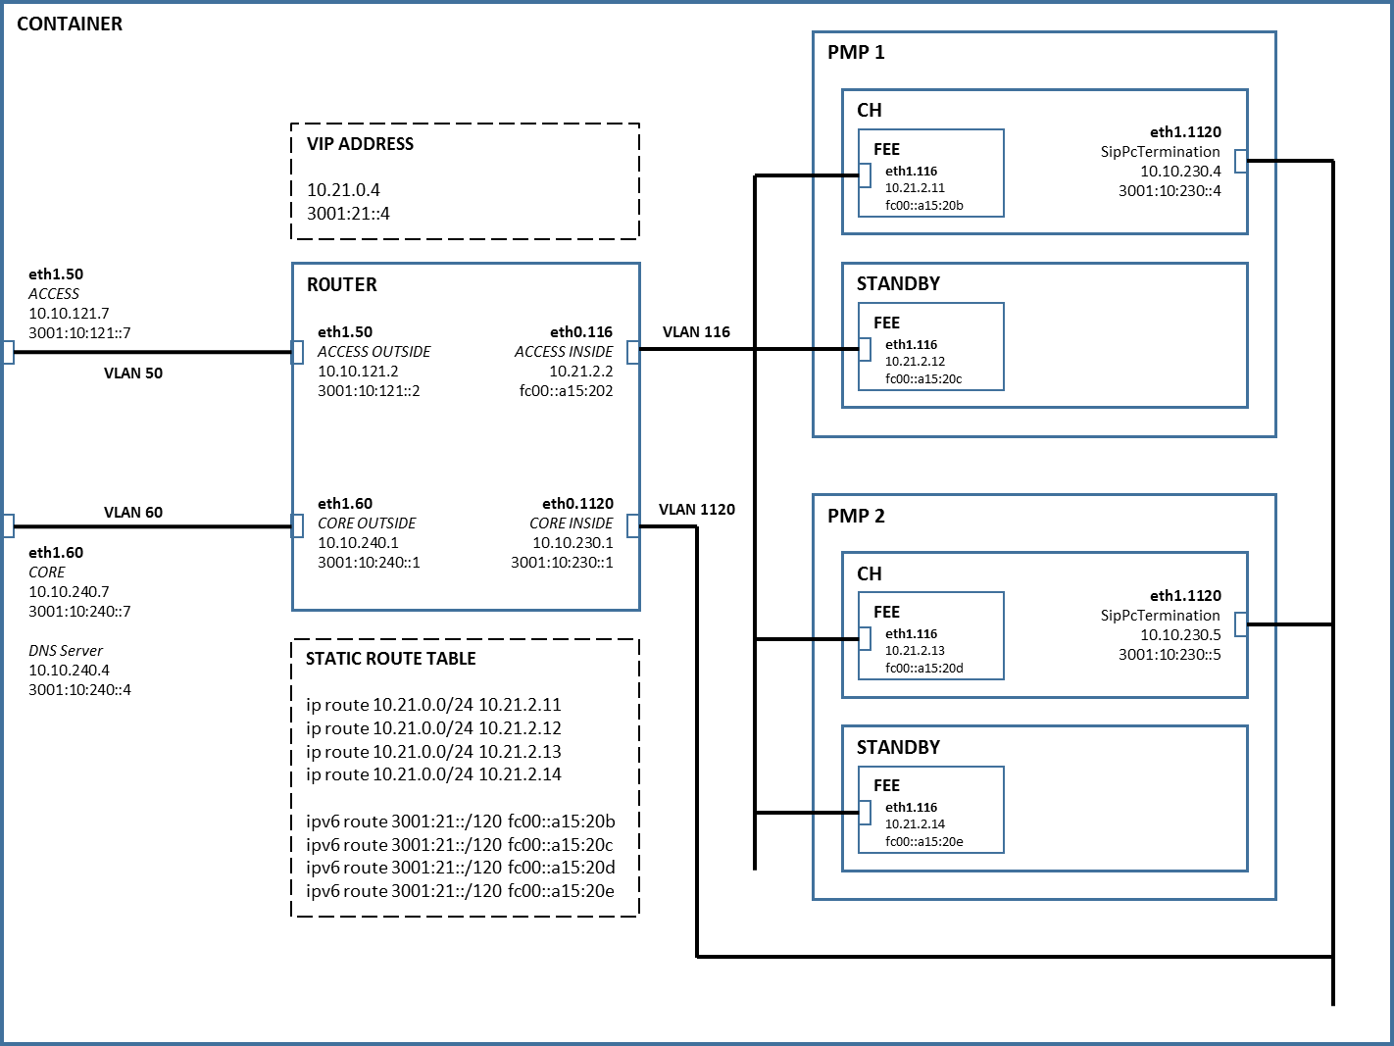
IP configuration for SIM ENV
By Ang Li

Slide 18
VR
One LLB has one VR
the net id of access network who is the first one created to use this LLB is the VR of LLB.
eVIP uses default VR 0.
VR 1
VR 0
router
SGC / PL
bond0.116
/ eth1.116
llb
SGC
fee
se
lbe

Slide 19
Veth/Bridge
veth – virtual ethernet can support the communication between two different namespace.
ip link add veth type veth peer name evipdev
VR 1
VR 0
br0
FEE
bond0.116
veth.116
eth1.116
IS
bond0
veth
evipdev
mx00
mx25
VR 1
VR 0
br0
FEE
eth1.116
veth.116
eth1.116
SBGv
eth1
veth
evipdev

Slide 20
Macvlan
The internal communication with the LXCs eVIP uses macvlan. This makes the containers appear as another processor on the internal network.
ip link add link bond0.1119 evip_macvlan0 type macvlan mode bridge
VR 0
FEE
SE
LBE
IS
eth1.116
macvlan
macvlan
macvlan
br
evipdev
bond0.1119
VR 0
LBE
vSBG
FEE
SE
eth1.116
macvlan
macvlan
macvlan
br
evipdev
eth3

Slide 21
Macvlan
blade_0_15:~$ cat /tmp/llb1fee_0_15.conf
lxc.utsname = llb1fee_0_15
lxc.network.type = macvlan
lxc.network.macvlan.mode = bridge
lxc.network.flags = up
lxc.network.link = bond0.1119
lxc.network.name = evip_macvlan0
lxc.network.hwaddr = 00:01:f6:01:01:08
lxc.network.type = vlan
lxc.network.vlan.id = 201
lxc.network.hwaddr = 00:00:00:01:01:09
lxc.network.name = eth1.201
lxc.network.flags = up
lxc.network.link = evipdev

Slide 22
IP6 Tunnel
Traffics between two elements are over ipv6 tunnel.
It add an additional IP header to the raw packet.
It limits the MTU a packet from SGC or UE to 1480 B
FE
SE
LBE
PN

Slide 23
IPVS
IPVS is used by LBE to distribute incoming traffic to a SGC application or forward a outgoing traffic to a SE element.
LBE
e_tun_1
e_tun_2
e_tun_3
e_tun_4
llb1lbe_0_11:~# ipvsadm -L
IP Virtual Server version 1.2.1 (size=8388608)
Prot LocalAddress:Port Scheduler Flags
-> RemoteAddress:Port Forward Weight ActiveConn InActConn
FWM 6000001 IPv6 wrr persistent 370000
-> [fc00::6e]:0 Route 6300 0 0
FWM 6000002 wrr persistent 370000
-> 169.0.0.110:0 Route 6300 0 0
LLB1lbe_0_11:~# ip rule show
0: from all lookup local
100: from all fwmark 0xc00/0xffffff00 lookup 4112
100: from all to 169.0.0.110 lookup 100110
LLB1lbe_0_11:~# ip route show table 100110
default dev e_tun_1 scope link

Slide 24
Firewall
VR 1
VR 0
router
SGC / PL
bond0.116
/ eth1.116
llb
SGC
fee
se
lbe

